Slide 1

Group 8
DATA7001 Introduction to Data Science
Group Project
28-Oct-2020
Notes:
Duration: 0:15.
Speaker: CJRS.
Welcome to our presentation for DATA7001. We are group 8.

Slide 2
Group 8
Making the Data Confess
Fit for Use
Getting the Data
Storytelling (Live Demo)
Problem Solving with Data
Siamak Adeli Koodehi
Cristhyan Cardona Garcia
Matthew Colwell
Christopher Symons
Hai Hung Vu
Notes:
Duration: 0:15.
Speaker: CJRS.
(I think we just quickly say first names and move on.)

Slide 3
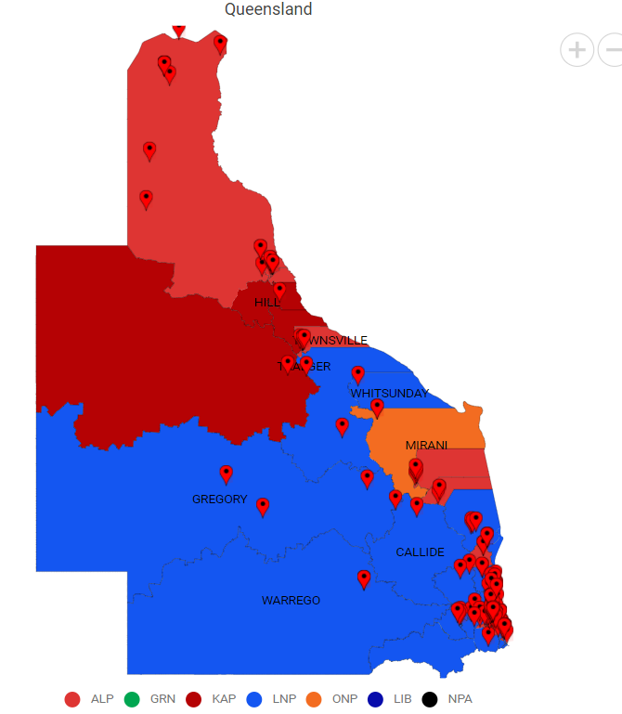
The Problem (Solving with Data)
Sports rorts - the National Audit Office found that Government spending grants were influenced by the applicant’s electorate locations¹.
Human centered design: we imagined a concerned taxpayer and engaged voter; how can that person work out whether government is spending fairly?
1. Sydney Morning Herald, T. Harris, 2020.
Notes:
Duration: 0:45.
Speaker: CJRS.
(Probably already too much content. May split in to two.)

Slide 4
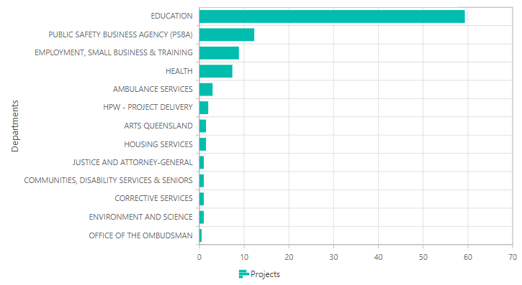
The Problem (Solving with Data)
Large volume of spending data: dozens of projects, billions of dollars, 93 electorates (Queensland state gov’t alone.)
How can our taxpayer visualize that spending to keep an eye on electorate Porkbarreling?
Notes:
Duration: 0:45.
Speaker: CJRS.
(Probably already too much content. May split in to two.)

Slide 5
[ live demo ( / storytelling with data ) ]
1
2
3
Notes:
Planned duration for this item: 2:30.
(Screen recording of demo of web tool by SAK and CCG with commentary.)

Slide 6
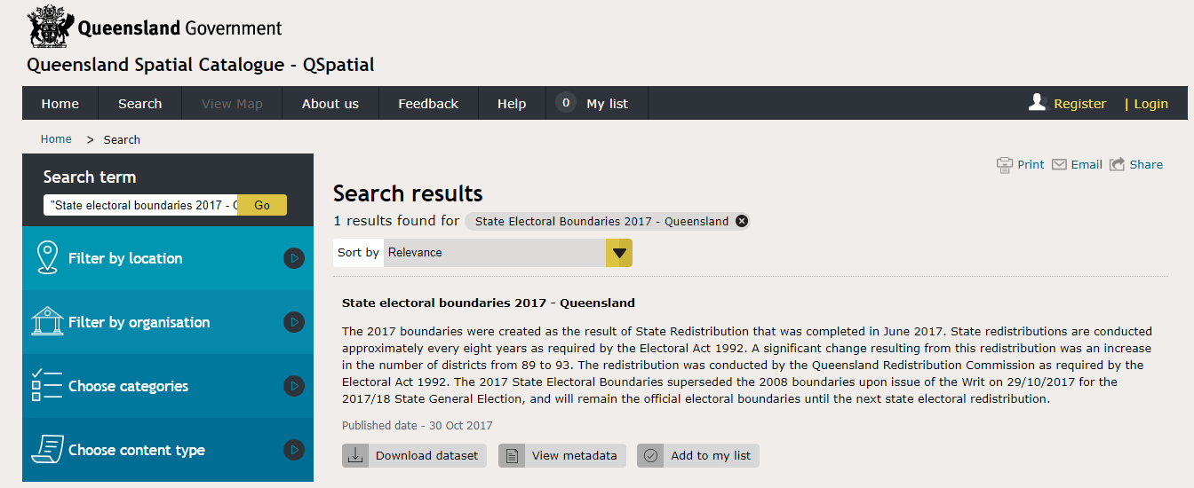
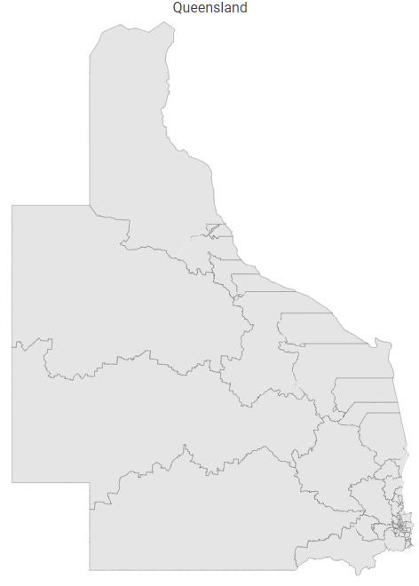
Getting the Data (I need)
Electoral boundaries: shape file (set of 93 named polygons in lat/long coordinate system) available from Qspatial.
Notes:
Duration: 1:00.
Speaker: CCG.

Slide 7
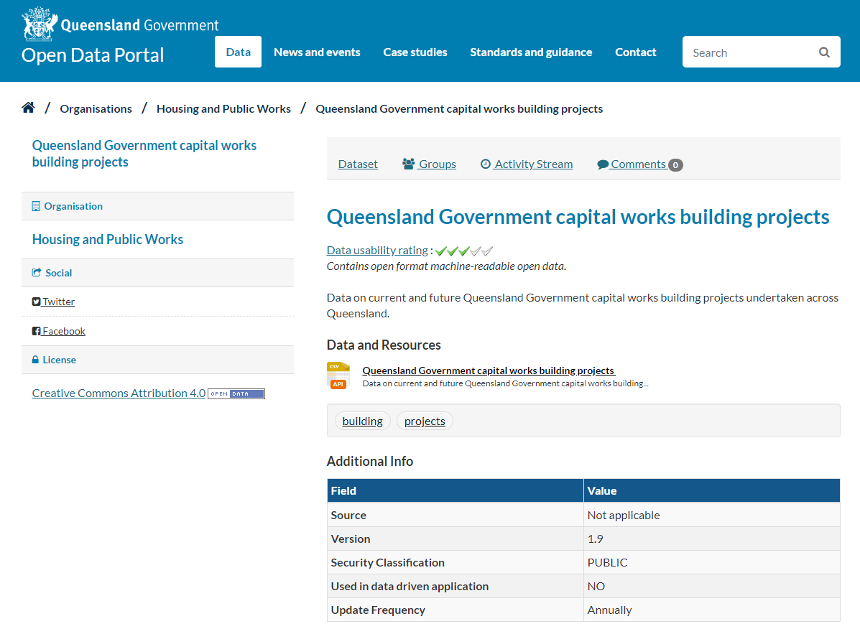
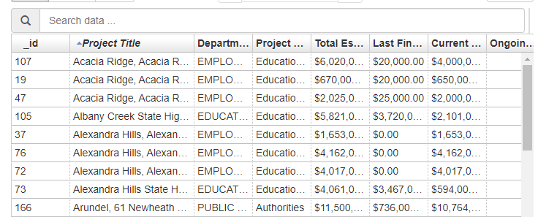
Getting the Data (I need)
Spending data: some success reading pdf tables from State Infrastructure Plan but challenging to get clean data; located alternative csv data at Qld Gov’t Open Data Portal.
Notes:
Duration: 1:00.
Speaker: CCG.

Slide 8
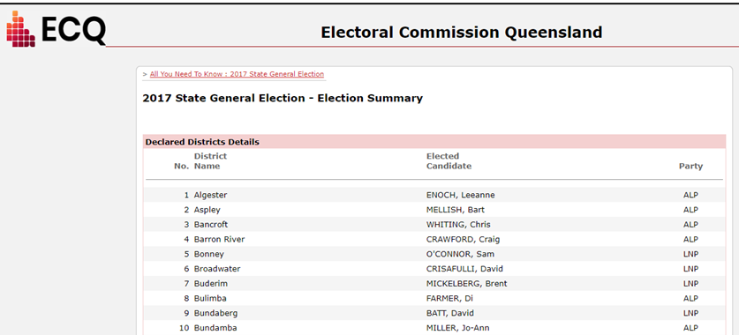
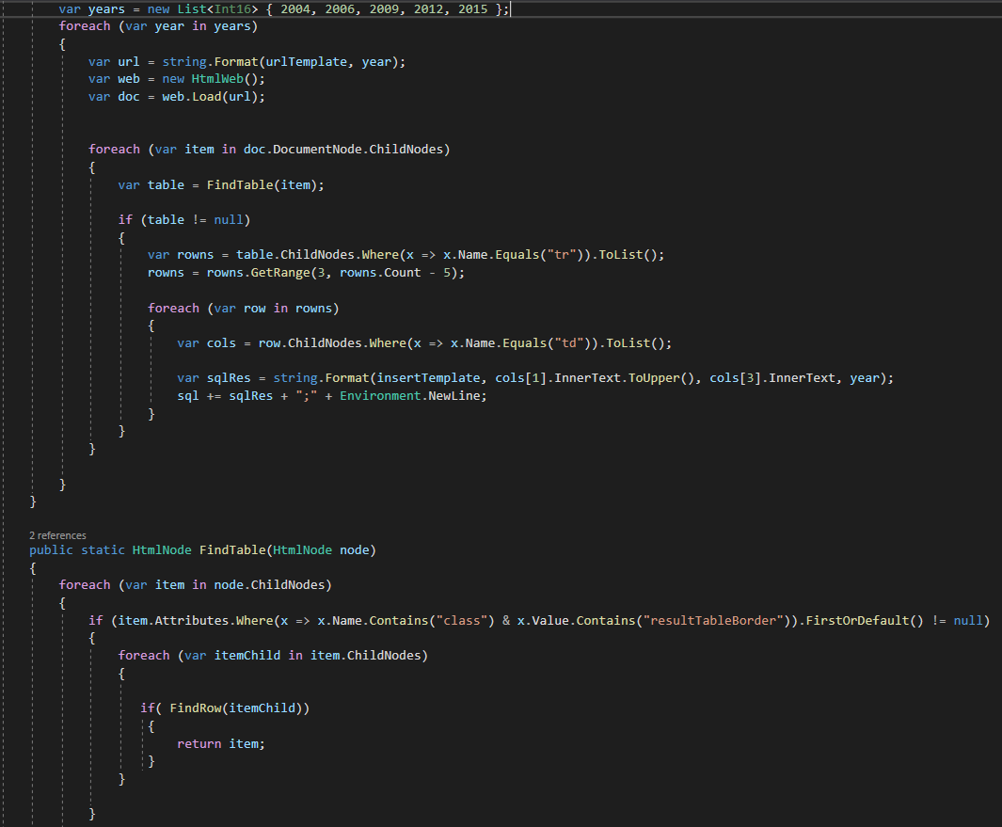
Getting the Data (I need)
Election results: First preference data collected through web scraping and final two candidate results by downloading and scraping PDFs for each electorate.
Notes:
Duration: 1:00.
Speaker: CCG.

Slide 9
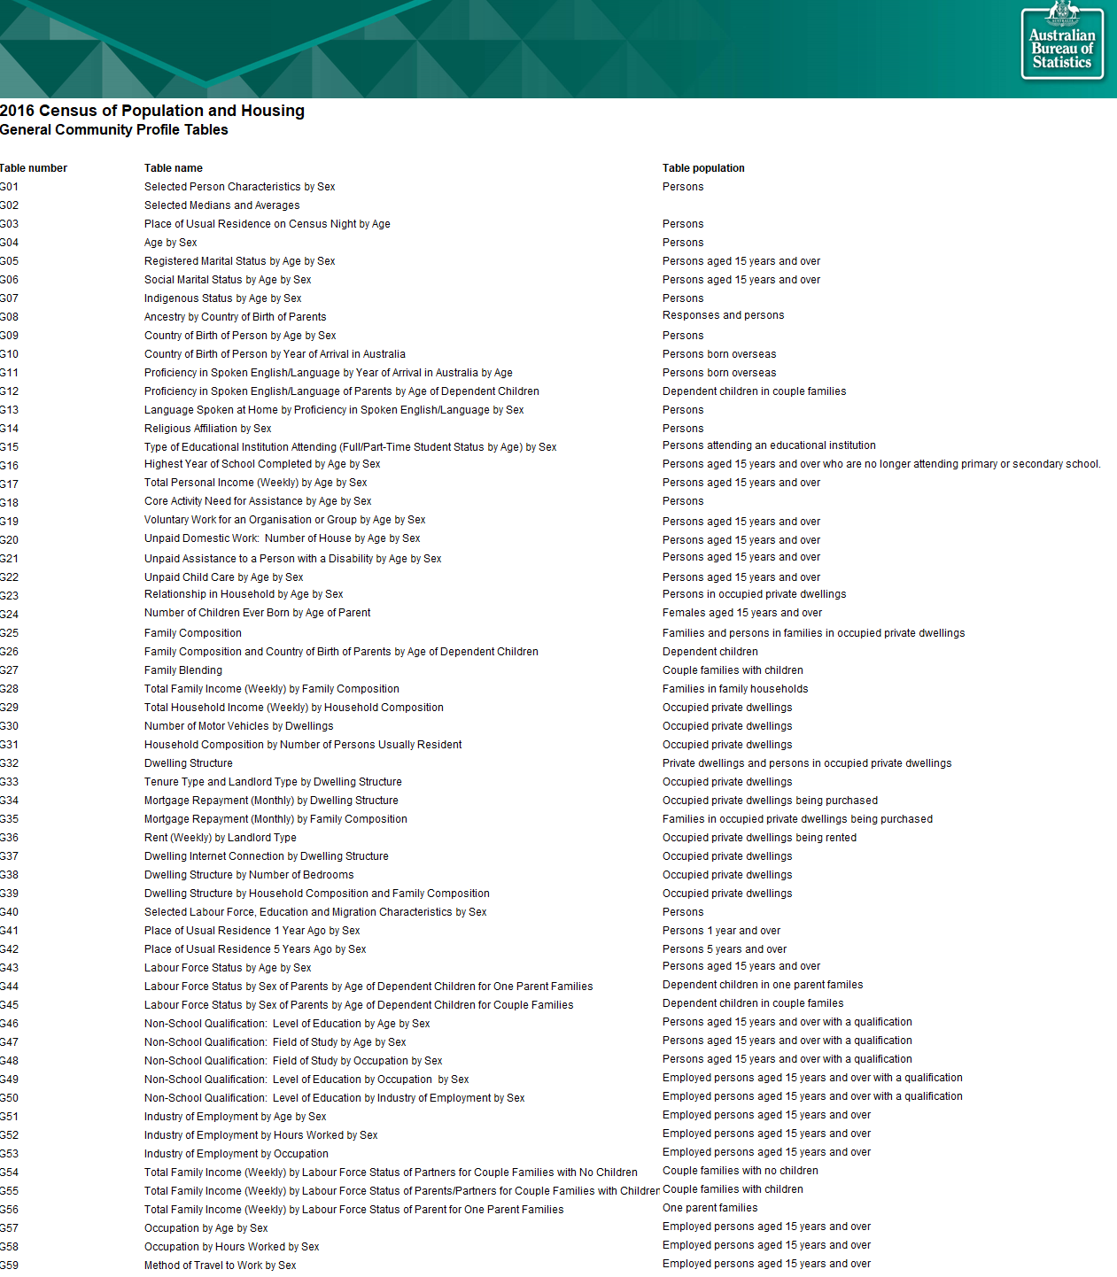
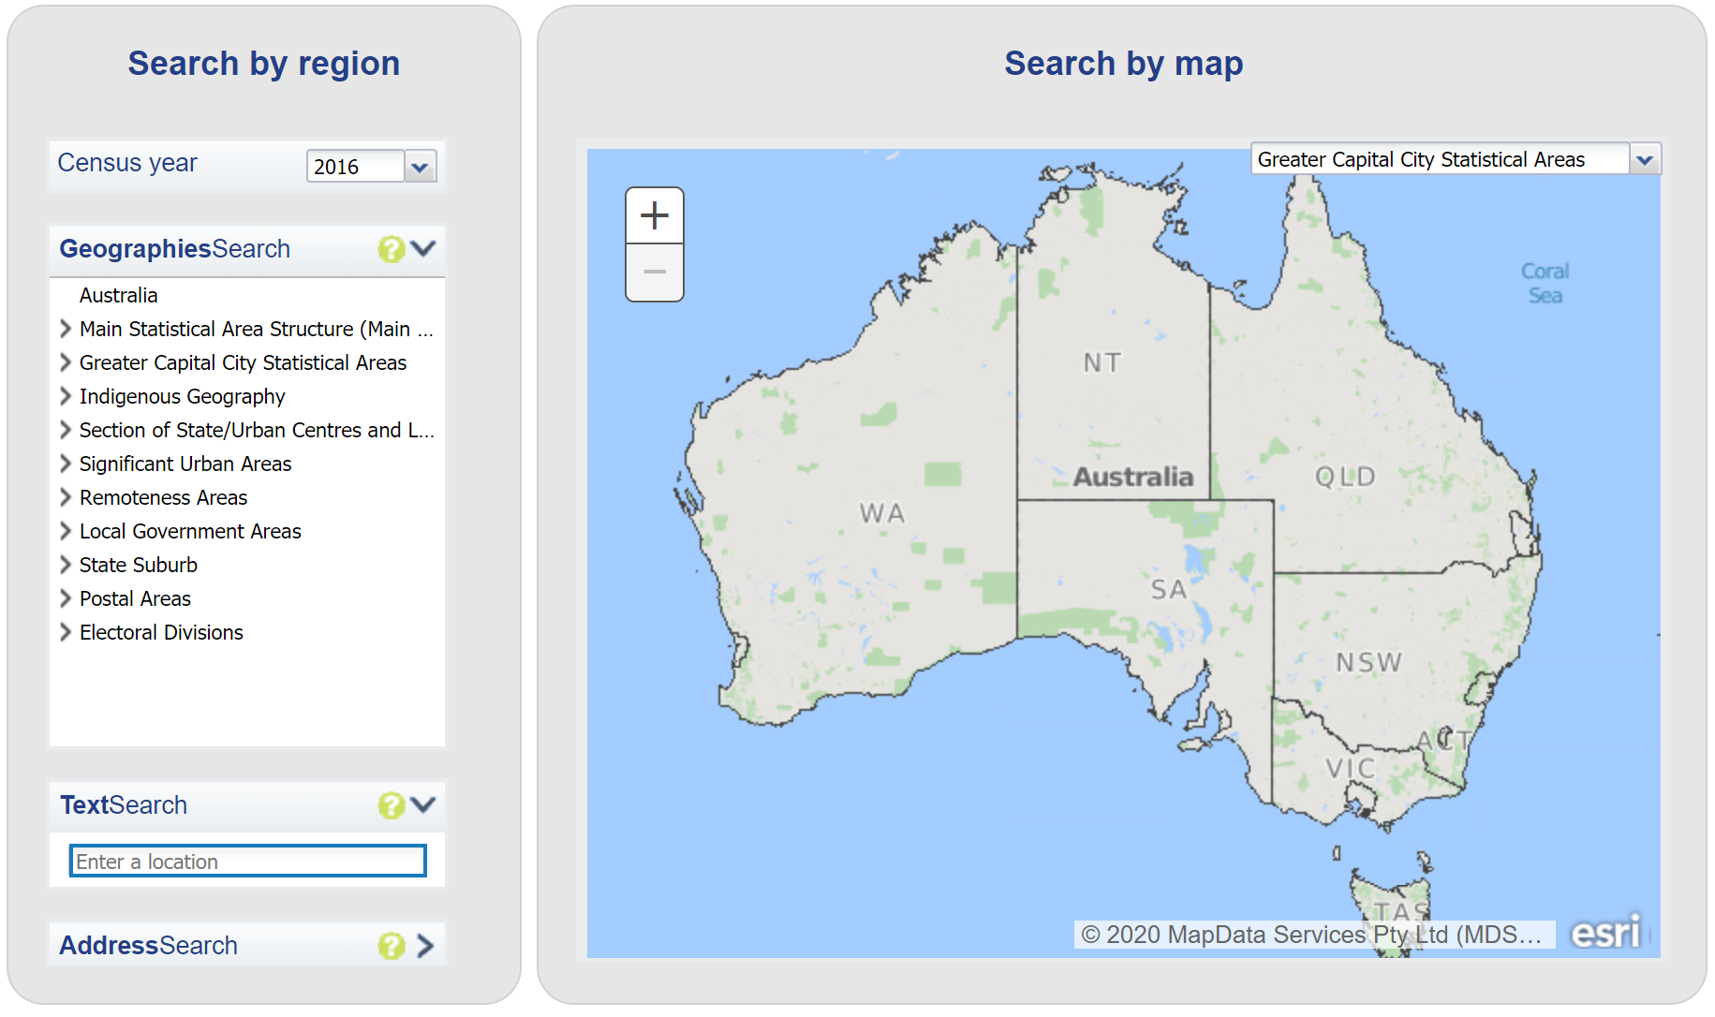
Getting the Data (I need)
Other/Census: Publicly available as CSV files from the ABS.
Notes:
Duration: 1:00.
Speaker: CCG.

Slide 10
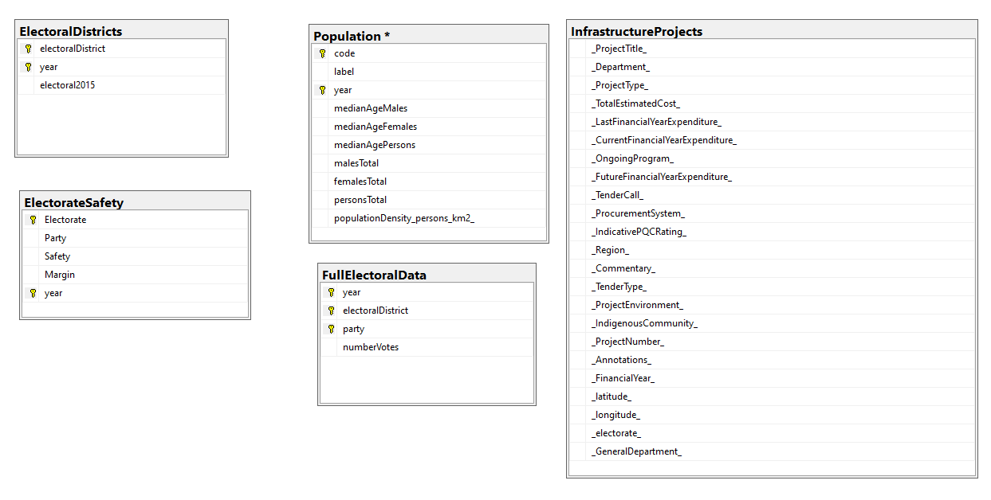
Getting the Data (I need)
Developing a cloud-based DataBase
Notes:
Duration: 1:00.
Speaker: CCG.

Slide 11
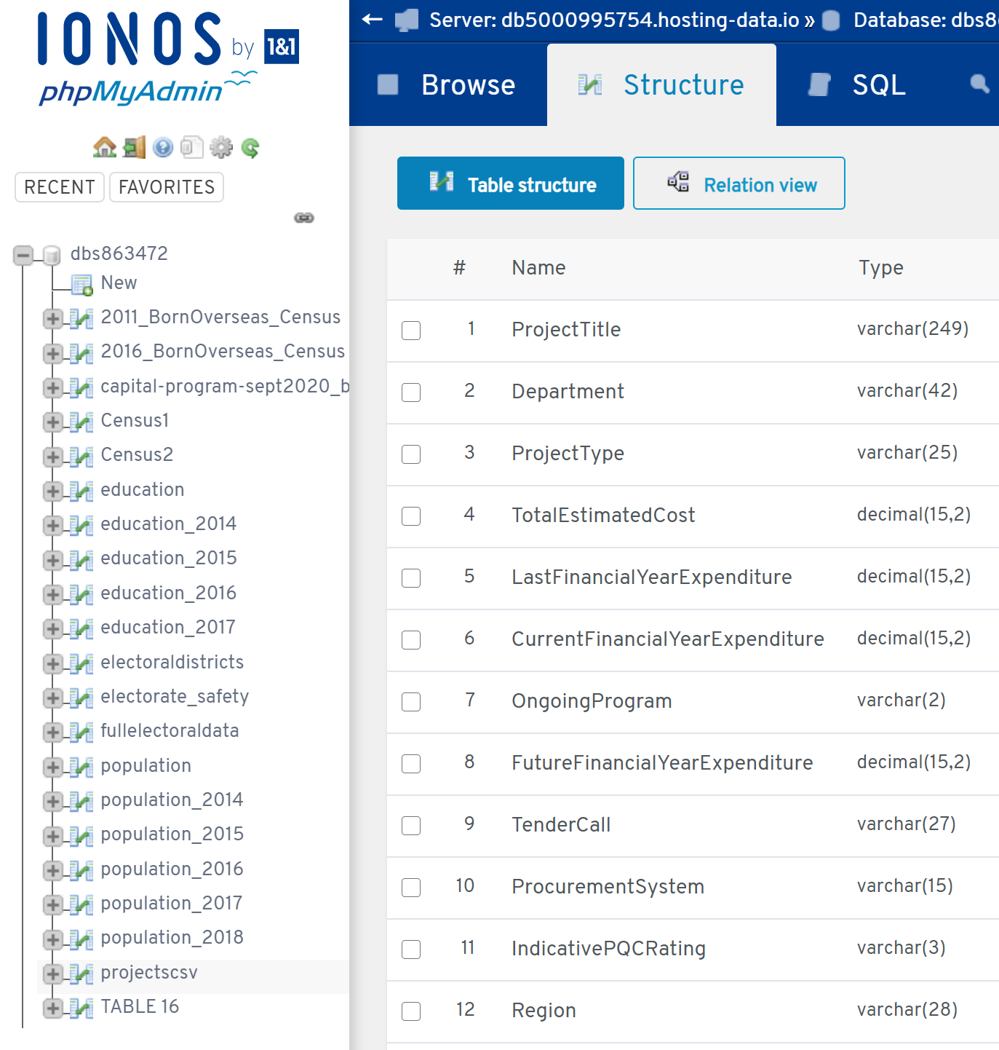
Is my data fit for use?
Collaboration: GitHub, Database
Data quality, polishing, aggregation and integration
Data Enrichment
Notes:
Duration: 0:30.
Speaker: SAK & MBC

Slide 12
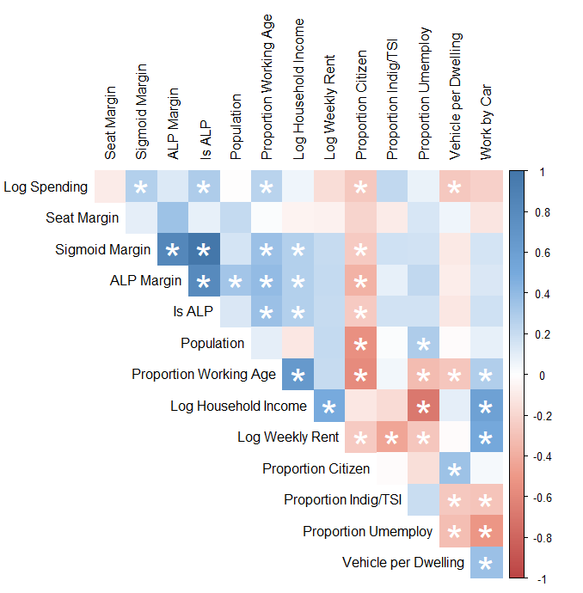
Making the data confess
Transform data
Correlations
Plot data
Develop models
Notes:
Duration: 1:00.
Speaker: MBC. ?HHV too

Slide 13
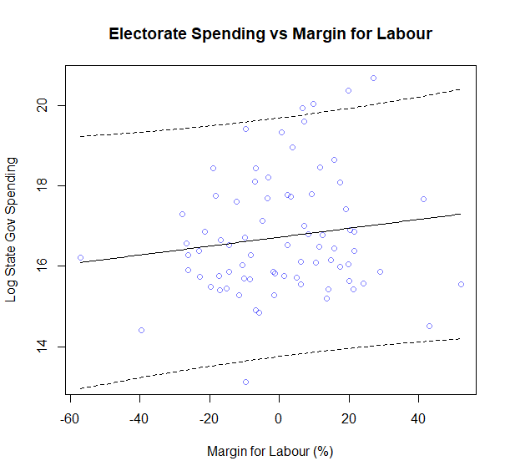
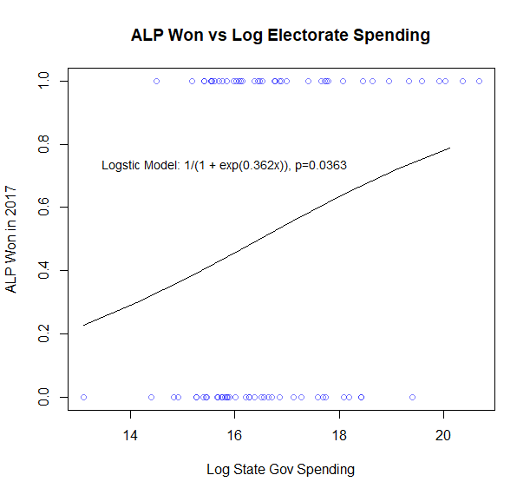
Making the data confess
Finding a relationship with statistical significance
Notes:
Duration: 1:00.
Speaker: MBC. ?HHV too

Slide 14
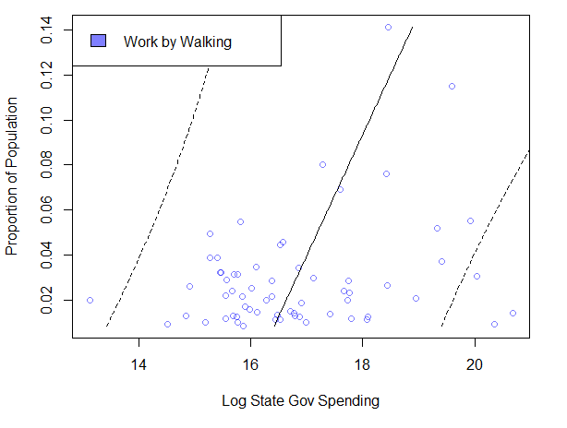
Making the data confess
Exploring unexpected correlations
Notes:
Duration: 1:00.
Speaker: MBC. ?HHV too

Slide 15
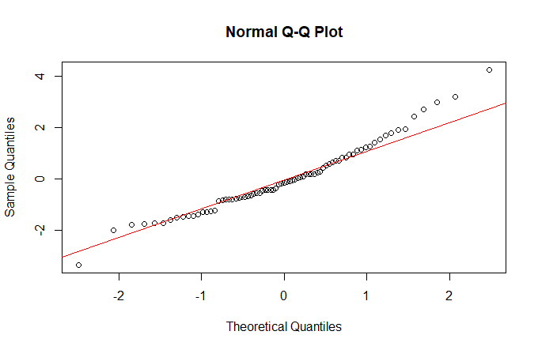
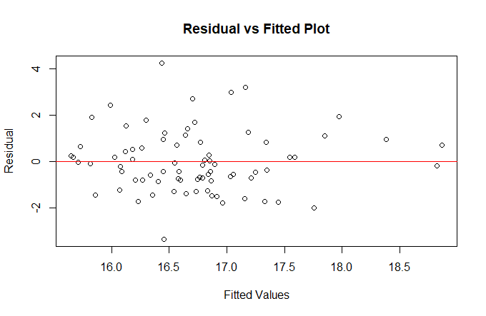
Making the data confess
Model assumptions on residual were validated and proved to be reasonably held based on various plots
Notes:
Planned duration for this slide: 1:00.

Slide 16
Conclusion
What we did (data science process).
What we found (very briefly).
What we could do next: more advanced statistical techniques, more and better data, temporal data, more sophisticated method of classifying seat safeness, more regions.
Notes:
Duration: 0:30.
Speaker: HHV.

Slide 17
Thank you / any questions
1
2
3
Notes:
Duration: 0:15.
Speaker: HHV.

